Slide 1
Getting your work published

Slide 2
Topics covered in this talk
Introduction to IOP
Why publish at all?
Choosing your journal
Writing your paper
Top 10 tips for getting published
Peer review process
Publication ethics
Post-acceptance
Post-publication
Notes:
Run through the main topics covered, and say that will invite questions at the end of each topic (please do ask!).

Slide 3
Introduction to IOP

Slide 4
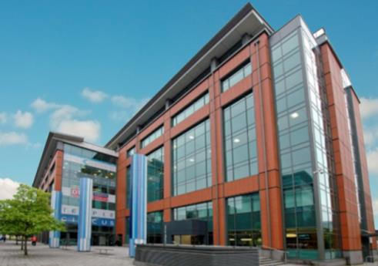

About IOP Publishing
  The wholly-owned for-profit publishing subsidiary of the Institute of Physics
  A society publisher embedded in the community we serve
  Mission: to deliver impact, recognition and value to the scientific community
  Over 300 staff worldwide (HQ in Bristol, UK)
  Provides high-quality publishing services to the global scientific community
  Publisher of 75 physical science journals
  eBooks programme
  Award-winning science journalism (including Physics World)
  iopscience.iop.org
Notes:
Where we work (Publishing) in Bristol. Emphasise that we are a learned society publisher

Slide 5

About the Institute of Physics
  A leading scientific society promoting physics and physicists since 1874
  Worldwide membership of 50,000+
  Headquarters in London, UK
  Mission to advance physics research, application and education globally
  Engages with policymakers, schools, universities, and the general public to develop greater awareness and understanding of physics
  iop.org
Notes:
IOP in the process of moving to this new office in King’s Cross!

Slide 6
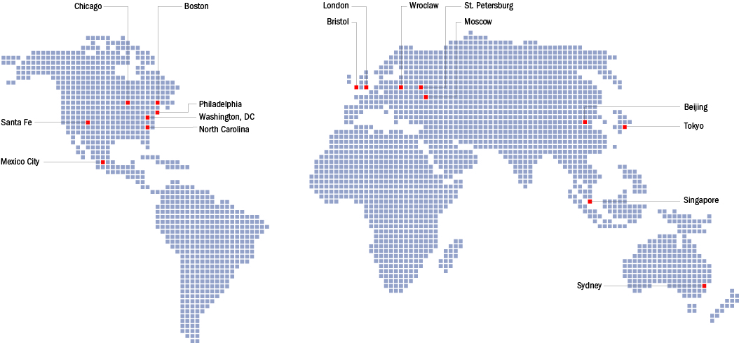
IOP around the world
Notes:
A society publisher, but staff (and authors/referees) based all over the world. Any questions about IOP?

Slide 7
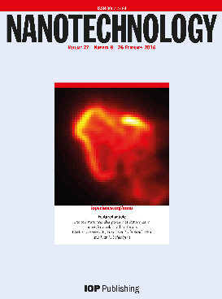
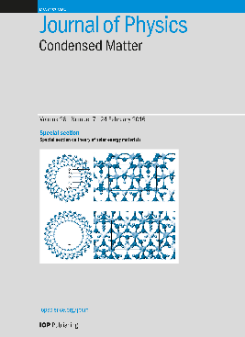
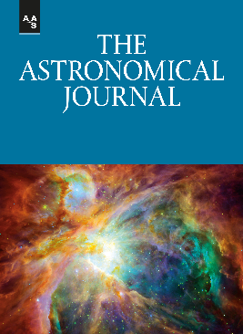
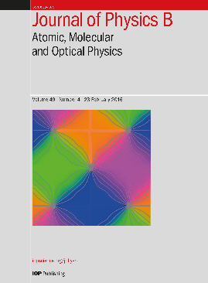

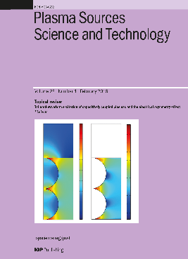

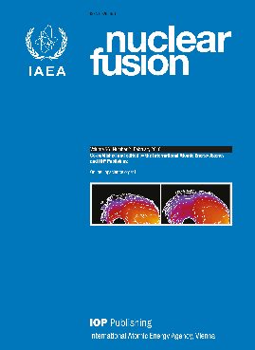
IOP Publishing: Journals
Notes:
(JS)

Slide 8
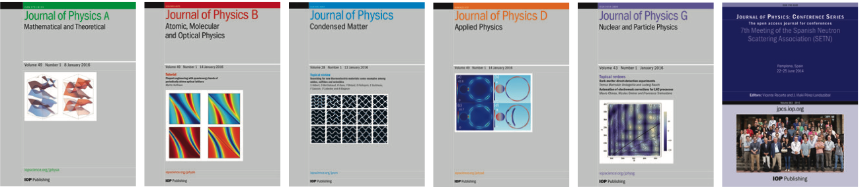
Journal of Physics series: 50th anniversary in 2017
Notes:
(JS)

Slide 9








IOP Publishing: eBooks
Notes:
(JS)

Slide 10

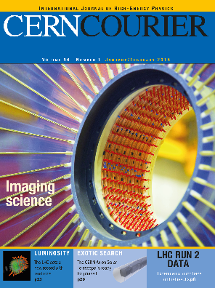


IOP Publishing: award-winning science journalism
Notes:
(JS)

Slide 11
How to get published
Notes:
(JS)

Slide 12
Topics covered in this talk
Introduction to IOP
Why publish at all?
Choosing your journal
Writing your paper
Top 10 tips for getting published
Peer review process
Publication ethics
Post-acceptance
Post-publication
Notes:
Run through the main topics covered, and say that will invite questions at the end of each topic (please do ask!).

Slide 13
Why publish at all?
  To share your knowledge (take field forward)
  To validate your research
  To help your career and reputation
  Publishing a paper in a peer-reviewed reputable academic journal
  is the universal way in which scientists communicate their research
“Connaître, découvrir, communiquer—telle est, au fond, notre honorable destinée”
“To get to know, to discover, to publish—this is the destiny of a scientist”
— François Arago, French physicist and astronomer
From 'De L’Utiliteé des Pensions', Œuvres complètes de François Arago (1855), Vol. 3, 621.
Notes:
Any questions re IOP? Will now go on to talk about getting your research published. But first a fundamental question…

Slide 14
Choosing Your Journal
Notes:
(JS)

Slide 15

Deciding on the right journal for your paper
Not a decision to take lightly!
Have to work with someone you trust
Many considerations affecting your choice (scope, reputation, speed etc)
Affects how you put together your paper
IOP mission to make it as easy as possible for you to publish your work with us
Options to meet the needs of authors at every stage of their career

Slide 16
Deciding on the right journal for your paper
First things first:
  Decide your first-choice journal before even writing your paper!
  Which journal will give you the most recognition for your work?
  What is your back up?
  What other factors do you need to consider?
Notes:
Choosing the journal before you even begin writing your paper as it may change how you present your results, how you write your abstract, length of submission, what figures you provide etc. This will save you time trying to reconfigure your paper to fit a journal’s submission criteria later on.

Slide 17
Deciding on the right journal for your paper
Considerations:
  Audience (peers)
  Scope/relevance
  Reputation
  Quality criteria
  Impact/visibility
  Speed of publication
  Likelihood of acceptance
  Open access or subscription model
  Costs (pages/figures/APCs etc.)
  “Think, Check, Submit!” thinkchecksubmit.org
Notes:
SCOPE/RELEVANCE: Does the journal publish other, similar papers? Is it theoretical, experimental, applied research? Does you work fit the subject matter covered by the journal? Will readers of the journal consider your work relevant to them? Is the journal broad in its scope or is it a specialist journal read mainly by a specific community?
We’ve highlighted two here that we will talk about in more detail… Think Check Submit is a useful site that gives you a checklist to use when choosing a suitable journal.

Slide 18
Deciding on the right journal for your paper: Impact
Measures of quality: Impact Factor
Impact Factor (2016) = No of citations in 2016 to articles published in 2014 and 2015
Number of articles published in 2014 and 2015
e.g. JPhysD published 1681 articles in 2014 and 2015
In 2016 it received 4351 citations to these articles (from across the entire literature)
4351 /1681 = 2.588 Impact Factor for 2015
  Other metrics such as Eigen Factors and H-index becoming more used
  Scopus
  Downloads
Notes:
Though contentious, the main measure of quality is still Web of Science’s Impact Factor, an Impact Factor > 2 is pretty good for a physics journal
SCOPUS is Elsevier’s database – and gives an alternative version of the IF (draws from a wider pool than the IF)
DOWNLOADS are a good metric if you’re interested in utility – how many people will read your work (most publishers now share their usage statistics, and certainly will on request)

Slide 19

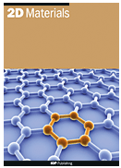
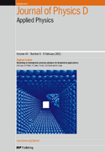


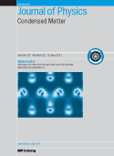
IF = 14.311
IF = 6.937
IF = 2.588
IF = 3.786
IF = 1.068
IF = 2.649
Notes:
Discuss the different tiers of journals. As previously mentioned, IF > 2 is pretty good for a physics journal. And above 3 is very good.

Slide 20
Deciding on the right journal for your paper: Open Access
Traditionally journals operate the subscription model
(Usually) free to publish, libraries pay for access
Authors are generally allowed to self-archive their accepted MS on a public repository (embargo period?) – Green Open Access
Increase in number of Gold Open Access journals
Final published article is made freely available upon payment of an article processing charge (APC)
APC paid to the publisher by the author/funder
Many journals (all IOP’s subscription journals) are now “hybrid”
Notes:
Discuss hybrid option

Slide 21
Once you’ve decided you will need to consider:
Submission requirements
  File formats
  Article info (article type etc)
  Author details (including co-authors), e.g. ORCID
  Keywords
  Referee suggestions
  Funders
  Charges (OA, page charges?)
  Other information (cover letter)
Supplementary files, e.g. data
Video files
Anonymization? (if required)
Check the journal guidelines!
Notes:
ORCID: Open Researcher and Contributor ID

Slide 22
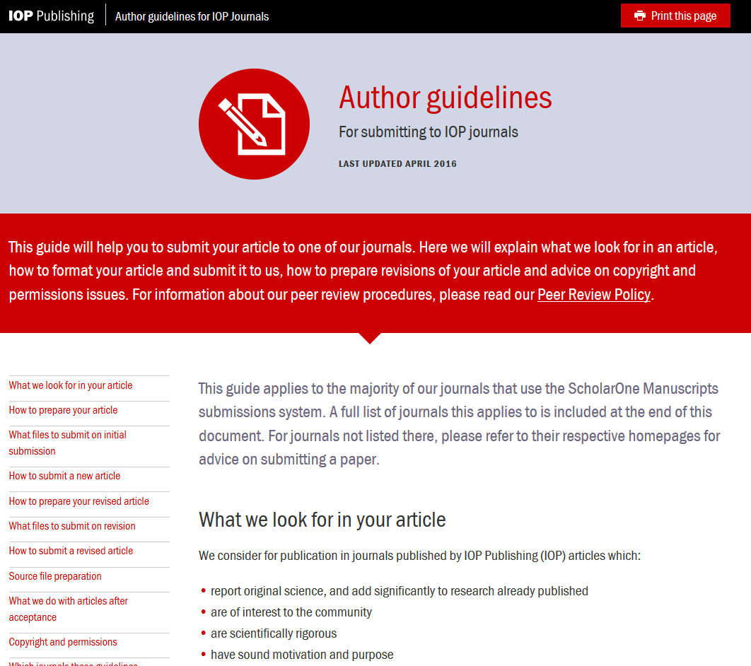
Notes:
Our recently updated guidelines for authors page which has all of the relevant information

Slide 23
IOP’s submission requirements
  IOP aims to make the submission process as simple as possible for authors:
No set submission format for your manuscript
Any relevant supplementary data allowed
Any received permissions
Can upload a file direct from the arXiv
PDF only submission. Source files (TeX/Word) only required after revision
Send us your compressed and archived (zip) files
  Full information for JPhysD can be found on our homepage www.iopscience.org/jphysd
Notes:
IOP is very flexible with format! Mention PDF only submission (i.e. no source files for original submission)

Slide 24
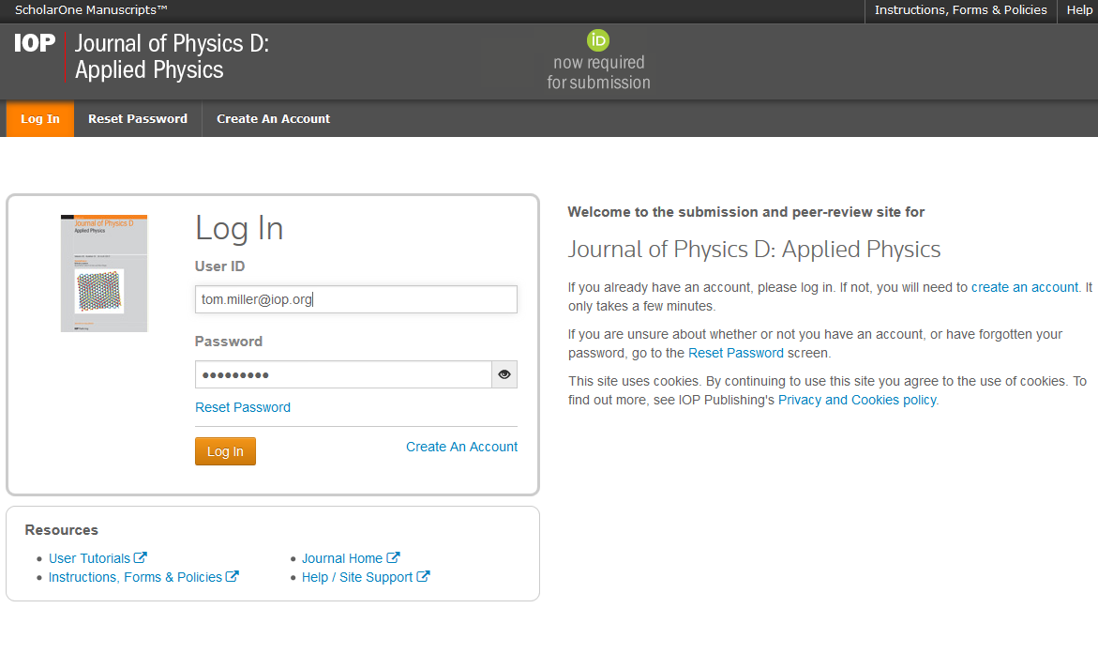
IOP Journals use ScholarOne system
Notes:
IOP Journals use ScholarOne: a standard, user friendly submission system. (you should allow pop-ups to be able to use the site properly!)

Slide 25
Writing Your Paper
Notes:
That’s all for choosing your journal. Any questions before we move on to Writing your paper? (SH)

Slide 26

Writing Your Paper
Before you start:
  Assess your main results – are they novel and important enough? Do they fill a gap in the research?
  Consider what your choice of journal requires
  Decide on the key message of your paper
  Prepare an outline/structure: headings, topics, context, significance
Notes:
(SH) 1st, do you have enough to actually write a paper?!

Slide 27
Writing Your Paper
Structure should include:
  Title
  Abstract
  Introduction
  Methods
  Results
  Discussion
  Conclusion
  Acknowledgments
  References
  Figures
Optional extra:
  Supplementary material

Slide 28
Writing Your Paper
Title :
  The most visible part of your paper
  Title: Concise yet informative; draws attention of the reader
Do | Don’t
Keep it simple | Be ambiguous
Be clear and descriptive | Use phrases or “jokes” that may not translate
Use key terms | Use acronyms
Notes:
This is what reviewers will use to gauge whether they want to review your paper and whether potential readers find your paper (Google search)

Slide 29
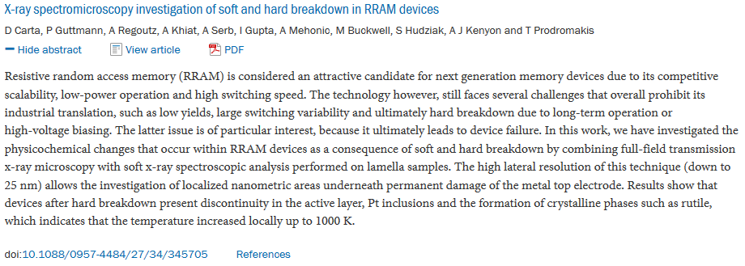
Writing Your Paper
Abstract:
  Your shop window!
  Summarises paper into one paragraph (<300 words)
  Should include your key result:
  What did you achieve?
Do | Don’t
Include key words and phrases | Copy your introduction
Be clear about what makes this paper worth reading | Use jargon, undefined acronyms or words not commonly used
Summarise aims, methodology and findings | Exaggerate or mislead
Notes:
This is what reviewers will use to gauge whether they want to review your paper too. And should be suitable for inclusion in Abstracting services.

Slide 30
Writing Your Paper
The introduction should:
  Describe the main goals and advances
  Give an overview of methods
  Set the work in the context of previous research
  Cite all relevant references
  For JPhysD, it is important you specify any applications relevant to your research

Slide 31
Writing Your Paper
Methods need to:
  Give enough information to allow duplication of your results
  Results and discussion need to:
  Show the significance and impact of your results
  Compare with other published work
  Discuss the implications and applications

Slide 32
Writing Your Paper
Your conclusion needs to:
  Summarize your major points
  Highlight the novelty and significance of your work
  Answer questions put in the Introduction
  Include your plans for future work

Slide 33

Writing Your Paper
Acknowledgements:
    Recognize the contribution of funders or other assistance
References:
  Cite the right references (relevant to the work and the journal you are submitting to)
  Original works both historical and recent
  Check for accuracy
  Follow the reference style of the journal; if there isn't one, just be consistent
Notes:
Cite any work that your research builds on (including your own).

Slide 34
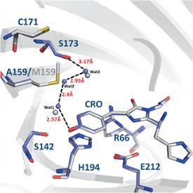
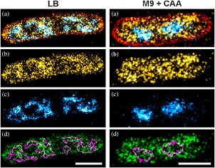
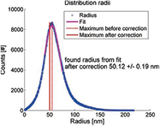
Writing Your Paper
Figures, tables, diagrams, charts:
  Representative, clear, well designed
  Use caption to ensure figures are self-contained. Include key terms and avoid acronyms if possible.
  TOP TIP – consider how the figures could be used post-publication
    Possible journal cover image
    To illustrate a news item
    On Twitter, Facebook, blog
    Posters and marketing materials
Notes:
Often figures are the first thing you prepare as they show the results.
They’re also one of the first things readers look at so it’s worth spending some time to make them look as good as possible and high resolution so readers can zoom in.
Make sure figure captions contain relevant key words and are self-contained so a reader can understand the figure without having to refer to the text.

Slide 35


Writing Your Paper
Get feedback and comments on your paper before submission
  Your supervisor
  Other colleagues
  Internal review
Make changes following their input
Get help from a fluent English speaker if you need it
Notes:
If a referee can’t understand the English, the paper will be rejected. Mention our partnership with Editage if presenting in non-native English speaking countries.

Slide 36

IOP’s
Tips for successfully writing up your research

Slide 37
Do…
Check the literature for similar results in your field
Use references that show context of your work and why it is new and significant
Decide whether you are writing for a specialist or non-specialist audience (your paper must be easy for that audience to understand)
Choose which journal you want to publish in before writing your paper
Spend a lot of time on your title and abstract – this will be what most people will see first. And judge your work on!

Slide 38
Do…
Keep abbreviations or technical terms to a minimum or clearly define them at first use
Avoid speculation, exaggeration or anecdotes – keep to the facts and clearly state your conclusions
Keep it clear and concise – even when there are no word limits – and use your own words
Allow plenty of time for rewriting
Get feedback from colleagues before submitting your article

Slide 39
Peer Review Process
Notes:
Any questions on Writing your paper, before we move on to the Peer review process? (JS)

Slide 40

Peer Review
The process whereby experts in the field assess an academic paper before deciding whether or not it should be published
  Vital part of publishing
  Critical filter for millions of research papers written every year
  Gives the scientific community and the public a reliable indicator on what to believe
  Gives authors feedback that can help to improve a paper
  Helps editors decide what to publish
Notes:
(JS)
Emphasise that it’s not perfect, but is broadly supported by the academic community, and is the best system we have.

Slide 41
Peer review models
Different types of peer review
Single-blind (most common)
Double-blind
Open
Collaborative
Post-publication
Check what type of peer review your chosen journal offers!
Notes:
SINGLE-BLIND: referee is not known to the author, but the author IS known to the referee
DOUBLE-BLIND, both the author and the referee are anonymous
OPEN review: everyone knows who everyone is
COLLABORATIVE: referees working together to review the paper
POST-PUBLICATION: public commentary following publication

Slide 42
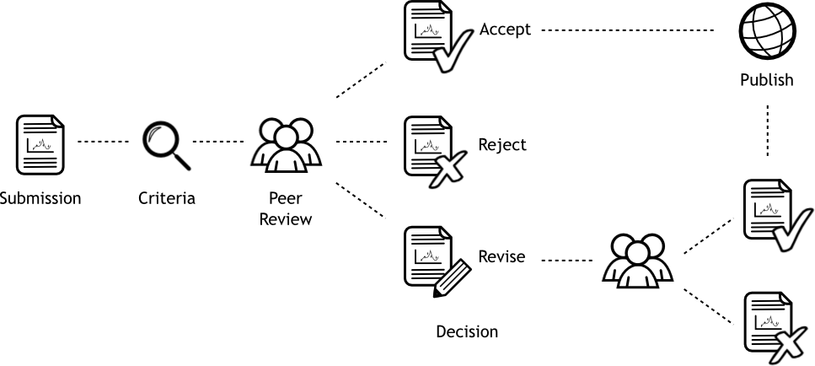
Peer review process
Notes:
Here is what the process looks like (give brief overview of this) …

Slide 43


Peer review: ‘Pre-refereeing’
The IOP editorial team review all submissions first
  Check for scope, quality of content and novelty (incremental?)
  Use to detect plagiarism or duplication
  Consult the journal’s Editorial Board if necessary
  If the paper is not suitable it will be rejected (or a transfer offered) at this stage
  Otherwise it will be sent to referees
Notes:
Our editorial team assess all submissions against some initial criteria which includes:
Discuss incremental: looking for a substantial step forward rather than an incremental advance

Slide 44
Peer review: referee selection
Referees are chosen based on:
  Subject expertise
  Independence
  Availability
  Reliability (previous record)
Authors don’t know who the referee is
Referee knows who the author is
Double-blind option for our Express titles
Single-blind
Notes:
Most of our journal operate the SINGLE-BLIND model as discussed previously but we are currently trialling DOUBLE-BLIND on our Express titles. Some people prefer this option, where the author is not named to the referee as it eliminates any UNCONSCIOUS BIAS

Slide 45
Peer review: Making a first decision
Normally require at least two referee reports (Adjudicator consulted if the two referees disagree) – typically takes a month or two
IOP referees are asked to rate Scientific rigour, Novelty and Significance
Decision is made by the IOP editorial team based on the referee reports
Immediate acceptance is unusual but does happen
Often ask authors for revisions based on the referees’ comments/requests
Rejection rate can be high - 50%+ common in high-quality journals
Notes:
At least two reports to make a decision, may involve an ADJUDICATOR or EDITORIAL BOARD MEMBER if the referees disagree.
Referees rate each manuscript out of 10 for Scientific rigour, Novelty and Significance (total 30).
Immediate ACCEPTANCE does happen but is quite rare.
Highlight TRANSFER option

Slide 46
Peer review: responding to referees’ comments
Being asked to revise is a great sign! It means the referees see merit in your work and it fits this journal
Read each referee’s report carefully (take some time!)
Respond to each and every comment specifically
Keep a list of all your changes and highlight them in the revised manuscript
If you disagree with the referees, clearly (and politely!) explain why
Never ignore a comment (if don’t understand then raise a query with editorial office)
This is free advice - use it!
Notes:
Important not to express any frustration with referees!

Slide 47
Peer review: following revision
Paper will be accepted if the referees are satisfied with the revisions
…or may be rejected if the revisions are not strong enough

Slide 48
Peer review: what if your paper is rejected?
Everyone has been rejected!
Use the advice you received to improve your paper
You can re-write your paper and re-submit it to another (hopefully more suitable) journal
If you think the decision was wrong most journals give you an opportunity to appeal
Notes:
Potentially do a show of hands to see who has submitted a paper before. Ask them to keep their hands up if they’ve been rejected before.
Discuss tiers of journals?

Slide 49
What if your paper is accepted?
You will receive an acceptance letter - congratulations!
Check if the journal needs you to do anything now; you may need to:
  Sign copyright form (assigns copyright to the publisher)
  Provide proof of permissions for reproduced figures
  Upload the source files (TeX/Word) for your manuscript
ACCEPTED
Notes:
And if your paper is accepted – congratulations! Time to celebrate!

Slide 50
Publication ethics
Notes:
Any questions about the peer review process? Before we cover post acceptance, mention publication ethics (a big issue in publishing) (SH)

Slide 51


Publication ethics
Examples of serious misconduct: plagiarism, falsification/fabrication of data
IOP is a member of COPE, the Committee for Publication Ethics - advice on handling misconduct cases
We routinely use iThenticate, a plagiarism detection tool
Read our ethical policy for authors at: http://ioppublishing.org/img/landingPages/guidelines-and-policies/ethical-policy.html
Top ten tips on publishing ethically…
Notes:
(SH) Ethics - a big issue in publishing (high profile retractions of papers).

Slide 52
Do
Be honest in making claims for the results and conclusions of your research
Credit all those that have made a significant contribution
Check your funder’s copyright/open access policy
Disclose any potential conflicts of interest
Get permission to re-use anything you haven’t created yourself
Respond to all reviewer’s reports, even if you don’t agree

Slide 53
Don’t
Fabricate, falsify or misrepresent data or results
Submit an article to more than one journal at a time
Add someone as a co-author without their permission
Sign any forms on behalf of your co-authors unless you are authorized to do so
Copy and paste from other articles, including your own – this may be classed as plagiarism or duplicate publication
Take any criticisms of your work from referees personally
Notes:
Any questions re Ethics, before we cover post-acceptance?

Slide 54
Post-acceptance
Notes:
Any questions re Ethics, before we cover post-acceptance?

Slide 55
What happens after acceptance?
Your Accepted Manuscript will be made available online within 24 hours of acceptance
So you can promote your work to your peers as soon as it is accepted (email, social media etc)!
An earlier opportunity for your research to be read and cited
Notes:
AM is now rolled out to all our journals (citable doi)!

Slide 56
Proof stage
Your paper will be edited to meet the format of the journal (usually including an edit for English)
You will be asked to carefully check the proof of your paper
This is your last chance to make any (minor) corrections!
Your corrections will be made and the paper published online
You will be informed and sent a link to your published paper
Print publication will follow some time later
Notes:
Mention rough time scales - we are relatively fast

Slide 57
Post publication: Impact and visibility
Notes:
Any questions before we move onto post publication? (JS)

Slide 58
Post publication: author promotion
There are things you can do to help your paper be read and cited more!
Contact colleagues in your field and people you’ve referenced (send link to paper) – they’ll be delighted!
Use your social media
Update your institutional homepage
Use your press office
Promote your publication at conferences
Cite your work!
We also play our part…
Notes:
(JS)
Briefly touch on KUDOS

Slide 59
Post publication: publisher promotion
Examples of things IOP does to help your paper be read and cited more:
Promote as part of subject collections and annual highlights collections
Highlight interesting work using social media (e.g. WeChat and Twitter @JPhysD)
Journalistic coverage of high-interest papers (community websites like nanotechweb, blogs like JPhys+)
We also press release newsworthy papers

Slide 60
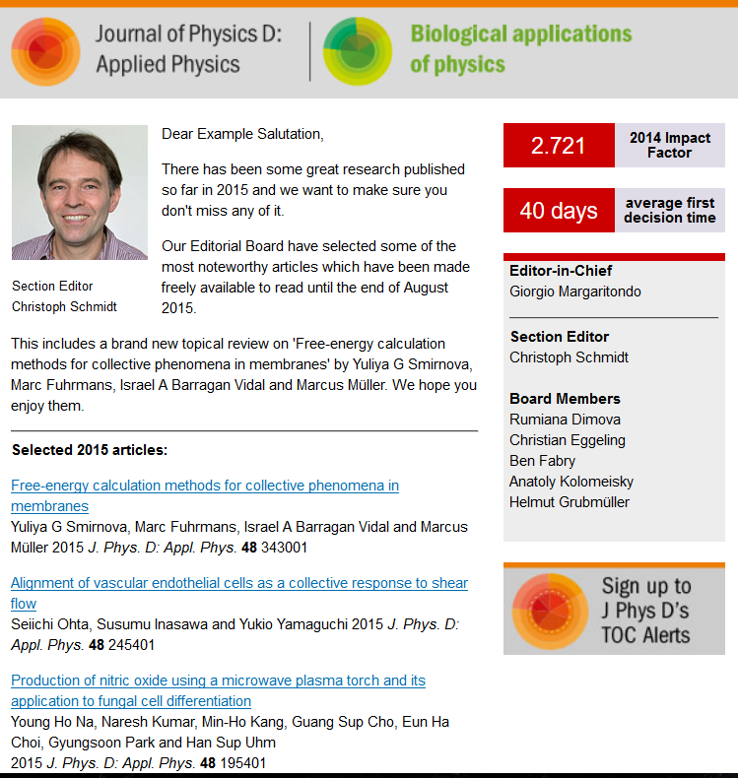

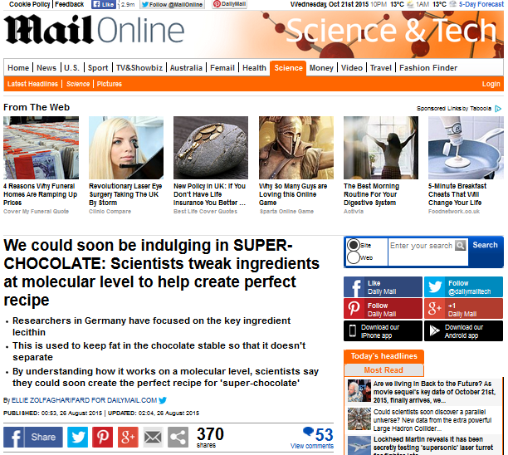
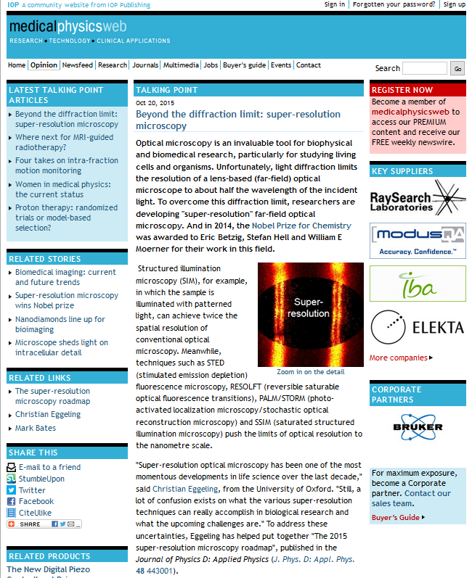
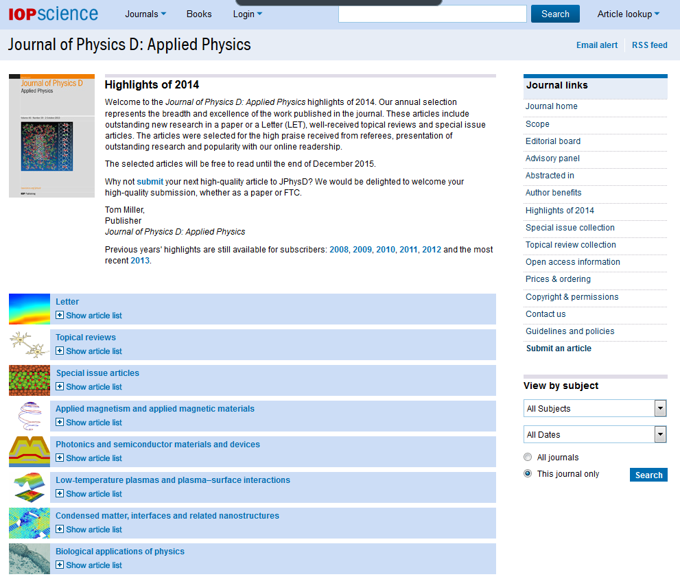


Promoting your published work
@JPhysD
Notes:
Many people might think that your paper appearing online or in print as being the final step in the publication process, however the next phase – promotion is equally important. If your paper is properly promoted:
more people will read it
more people will benefit from your research
the more value and impact your paper and you as an author can have.
Here are some examples of what JPhysD may do to promote your paper:
[Click] Highlight high quality work through our Email
[Click] Annual Highlights – picked by board members
[Click] Social media – a lot of journals have a presence on some sort of social media, and it can be a really quick and simple way to drive readers to a paper. JPhysD has a twitter account with around 3,000 followers.
[Click] We also recently launched our new Jphys series, Jphys+, highlighting news and
[Click] Working with our own publications, such the community websites, to write features about your work. Here MedicalPhysicsWeb are reporting on a recent article, the 2015 Super-resolution microscopy roadmap
[Click] It may also appear in one of our subject collections such IOP|Materials
[Click] Press Releases – we recently press released an article on modelling lecithin in chocolate to improve mouthfeel
[Click] You! Reference your paper, promote it to colleagues, departmental websites, talk about it at conferences, use your own social media accounts

Slide 61
Recap: topics covered in this talk
Introduction to IOP
Why publish at all?
Choosing your journal
Writing your paper
Top 10 tips for getting published
Peer review process
Publication ethics
Post-acceptance
Post-publication
Notes:
(SH) Recap the main topics covered - any further questions?

Slide 62
Contact
Baihua Wang
Baihua.wang@iop.org
China@iop.org
Notes:
(SH) Recap the main topics covered - any further questions?
62

